Slide 1
Presented by: Frankie Posillo

Slide 2
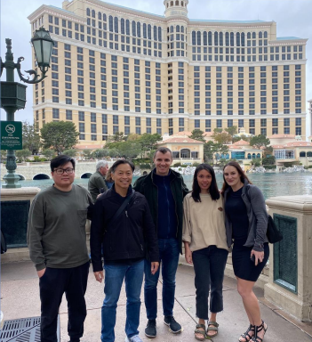
iDentalSoft Team Introduction
John (IT tech support)
Michael (CEO)
Peter (CFO)
Mien (migration & support lead)
Frankie (senior sales associate)
*2023 Team Meeting, Las Vegas

Slide 3
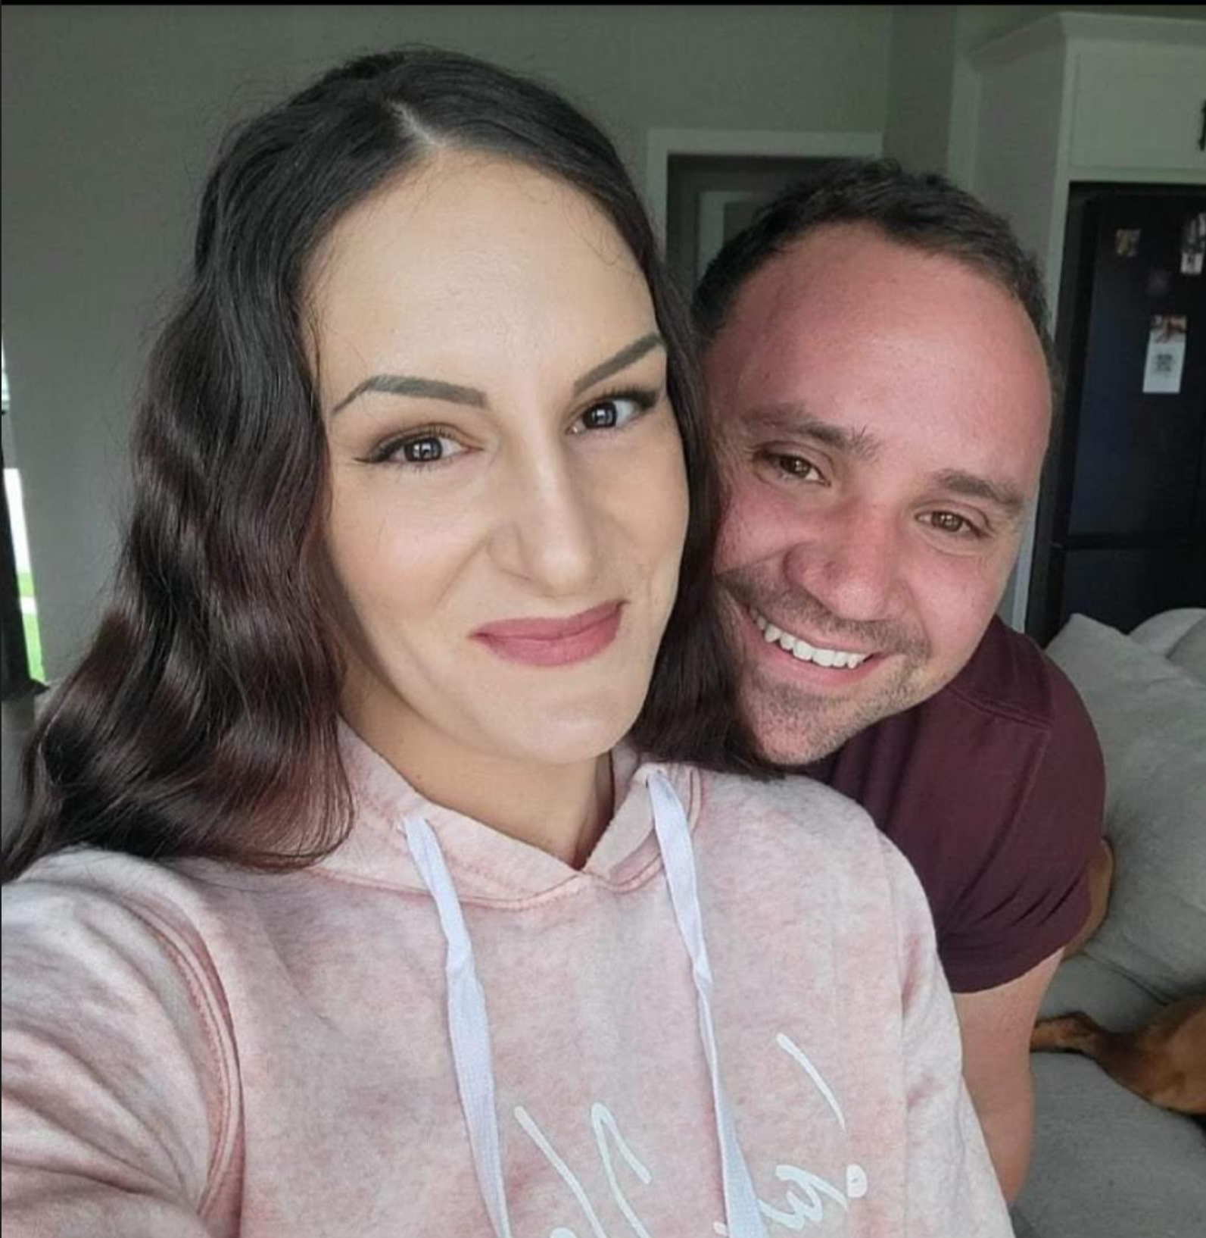
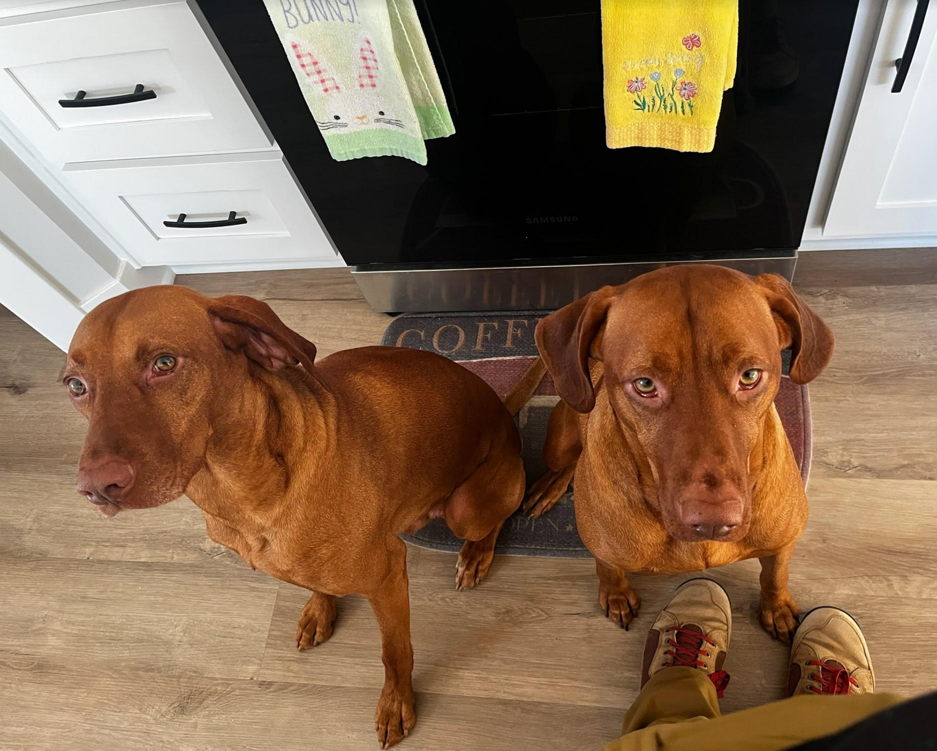
About Me
Personal
Professional
Worked in STL Dental lab for 4 years
- Support
- Customer service
- Sales
Been with iDentalSoft for 5+ years
- Sales
- Client Onboarding
- Training
Total Time in Dental: 9+ years

Slide 4
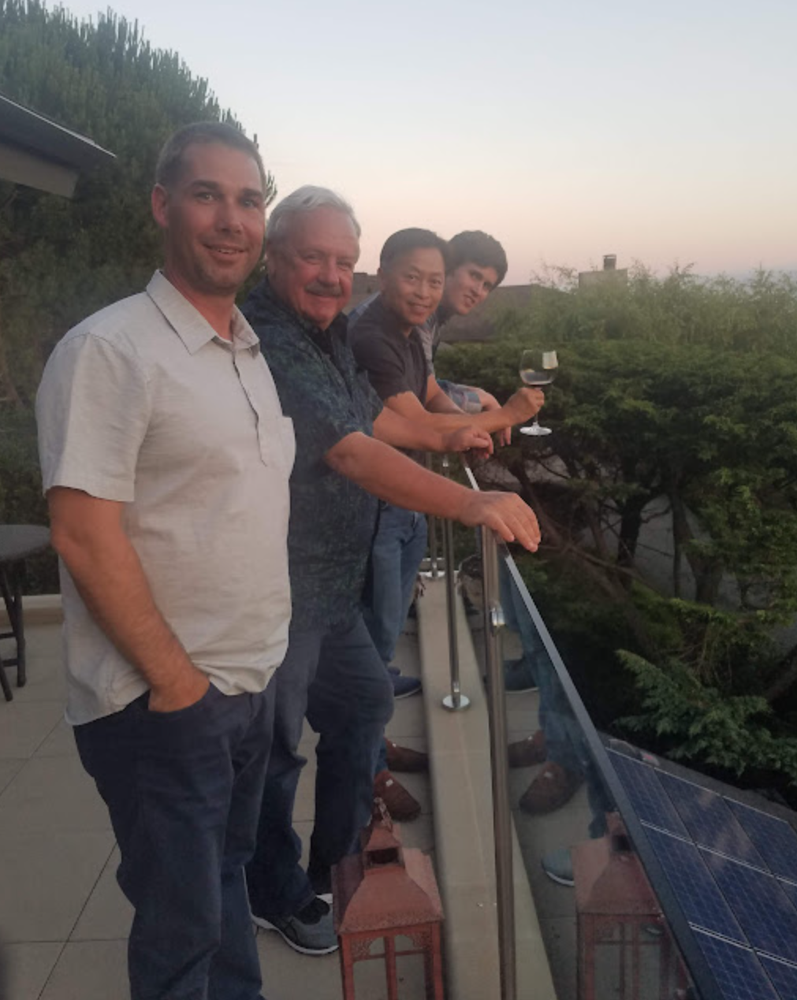
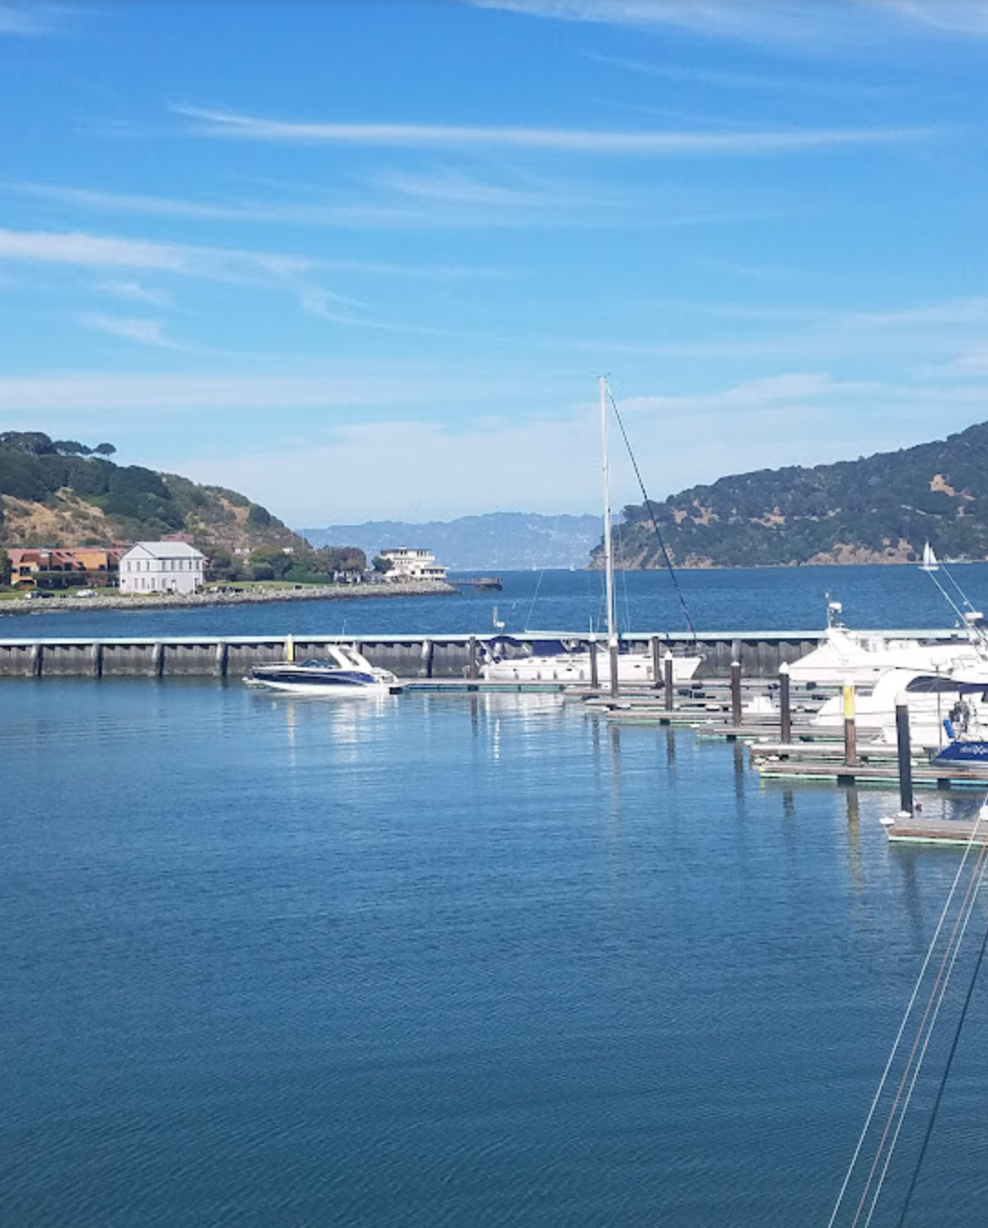
About iDentalSoft
Background
Size
Founded in 2010
Transitioned from server to cloud in 2013
6 different departments (sales, development, support, training, migration, etc.)
Offices in Silicon Valley CA and Kansas City MO
Privately owned (backed by venture capitalists)
1200+ dentists/dental specialist using iDS (public & private)
National & Internationally based (clients on 5 continents; 15 countries)
145,000 patients treated every month & documented in iDS
7+ services offered
* 2019 Team Meeting
Corinthian Yacht Club, CA

Slide 5
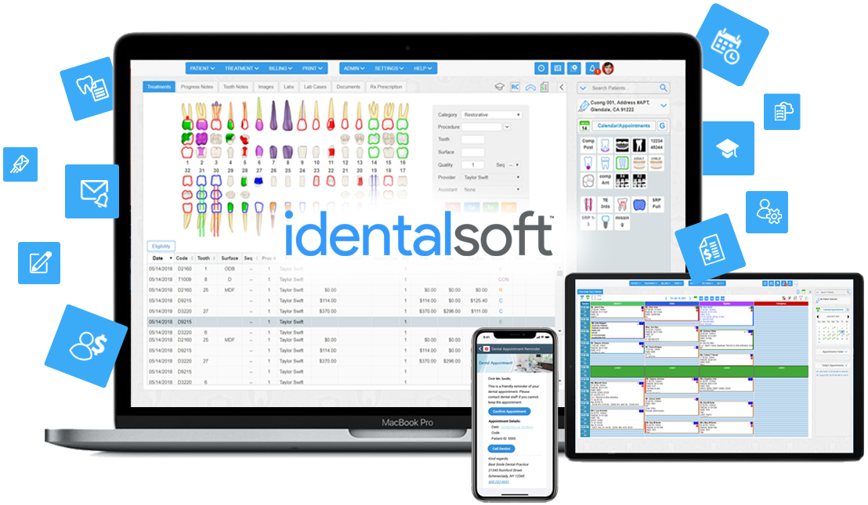
What is iDentalSoft?
iDentalSoft is an all-in-one, cloud-based
dental practice management platform
for the modern dentist.

Slide 6
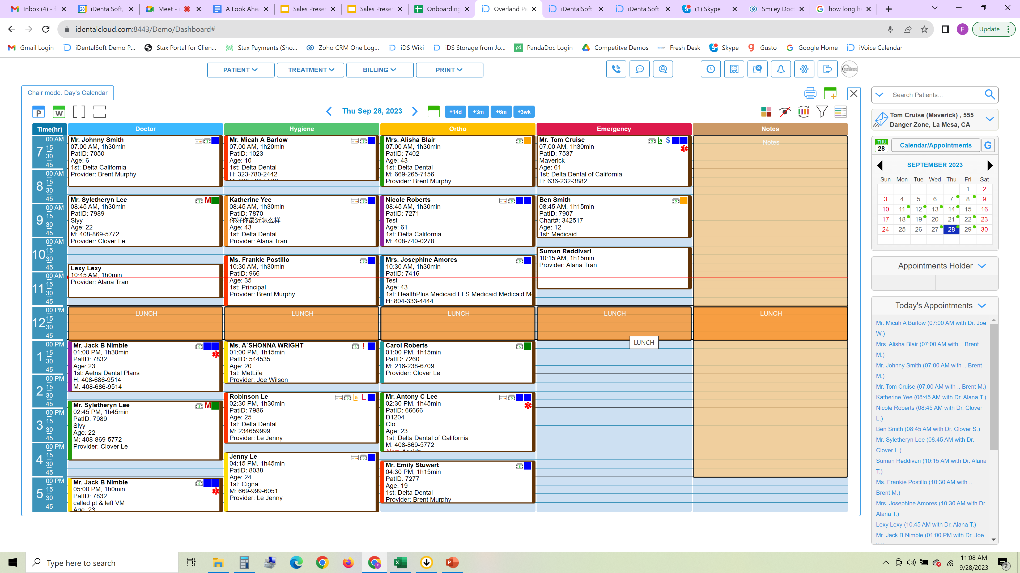
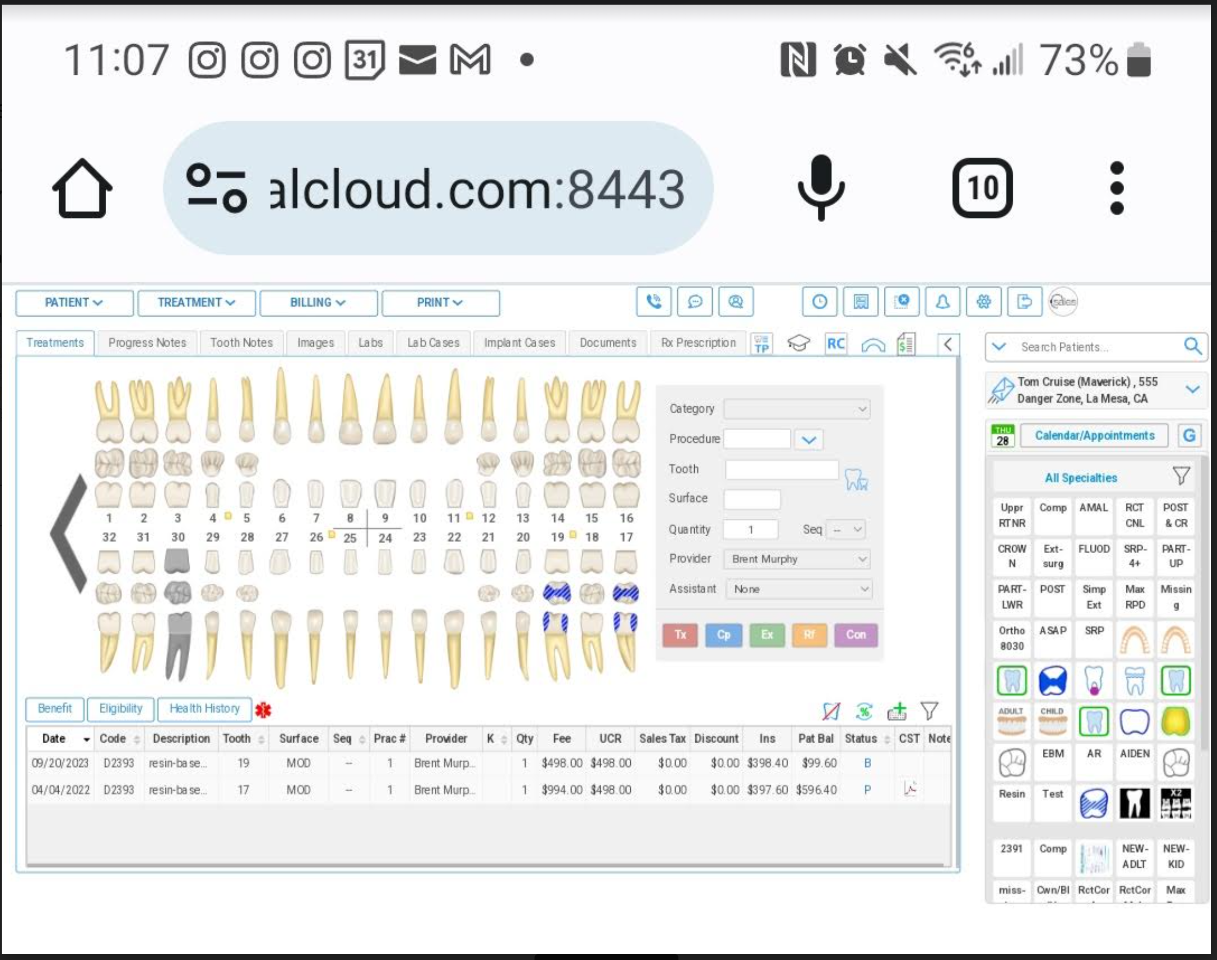
What does it mean to be a “cloud-based” dental software?
Cloud-based
Server-based
iDentalSoft will store the data & manage backups; all data in the cloud
Dental office can log in from any device
iDentalSoft is an all-in-one solution; one program offering many services
Dental office is responsible to store their own data, maintain on-site server & handle their own backups
Dental office is limited on where they can access the software
Dental office uses several different companies for the services needed

Slide 7
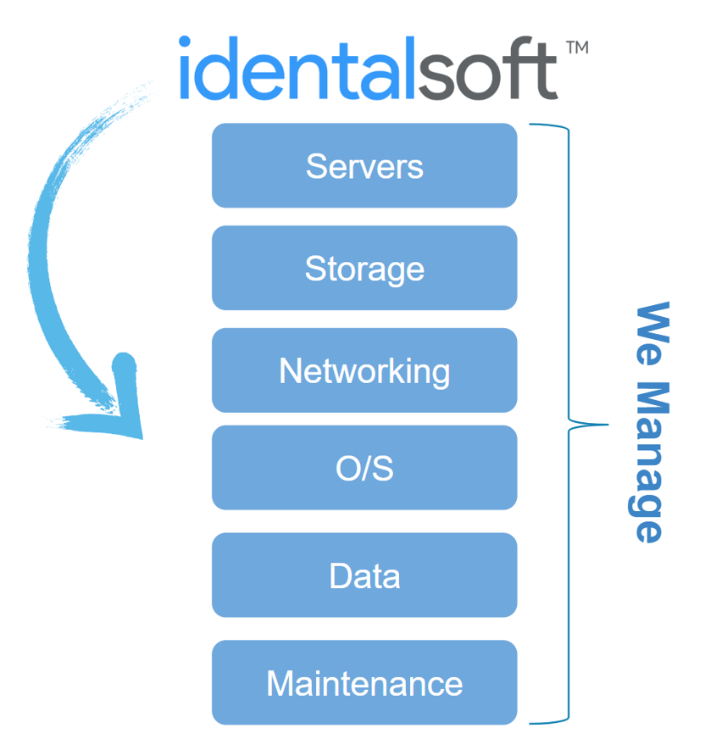
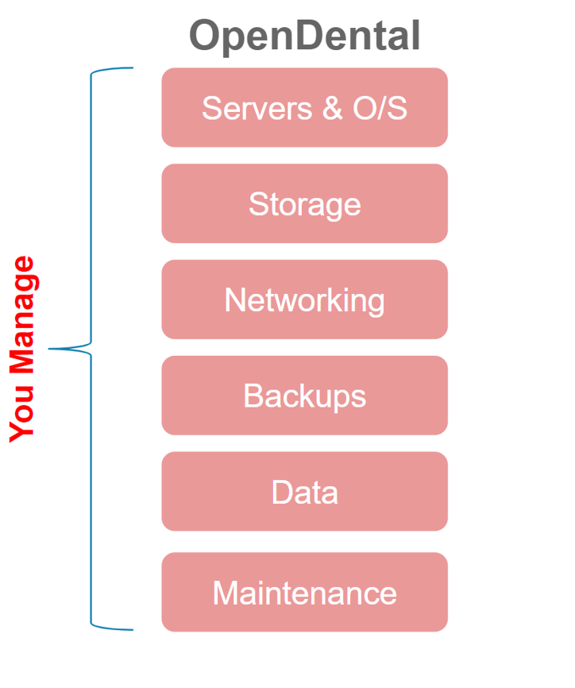
Cloud vs. Server

Slide 8
How is iDentalSoft’s data stored?
iDentalSoft is hosted on AWS and flexible platform meets every client’s demand. Uniquely, iDS manages client databases individually to secure data crossing, simplify user boarding and data management.
Hybrid: Shared services (share server)
Private: Separate services (allocated server)
Custom: Combination of having a private application, database hosting service plus secure all ports (single port use 443).

Slide 9
How we manage our dental offices
iDentalSoft provides full support and services:
Custom development (enhancements)
Data Migration
- Custom migration (for non-standard data)
- Full automation tool
- Full migration to a Live Ledger (most dental software, Dentrix, OpenDental, etc…)
Support Call Center
- Practice Management services/support
- Billing/Insurance Collection services/support
- Payment System services/support

Slide 10
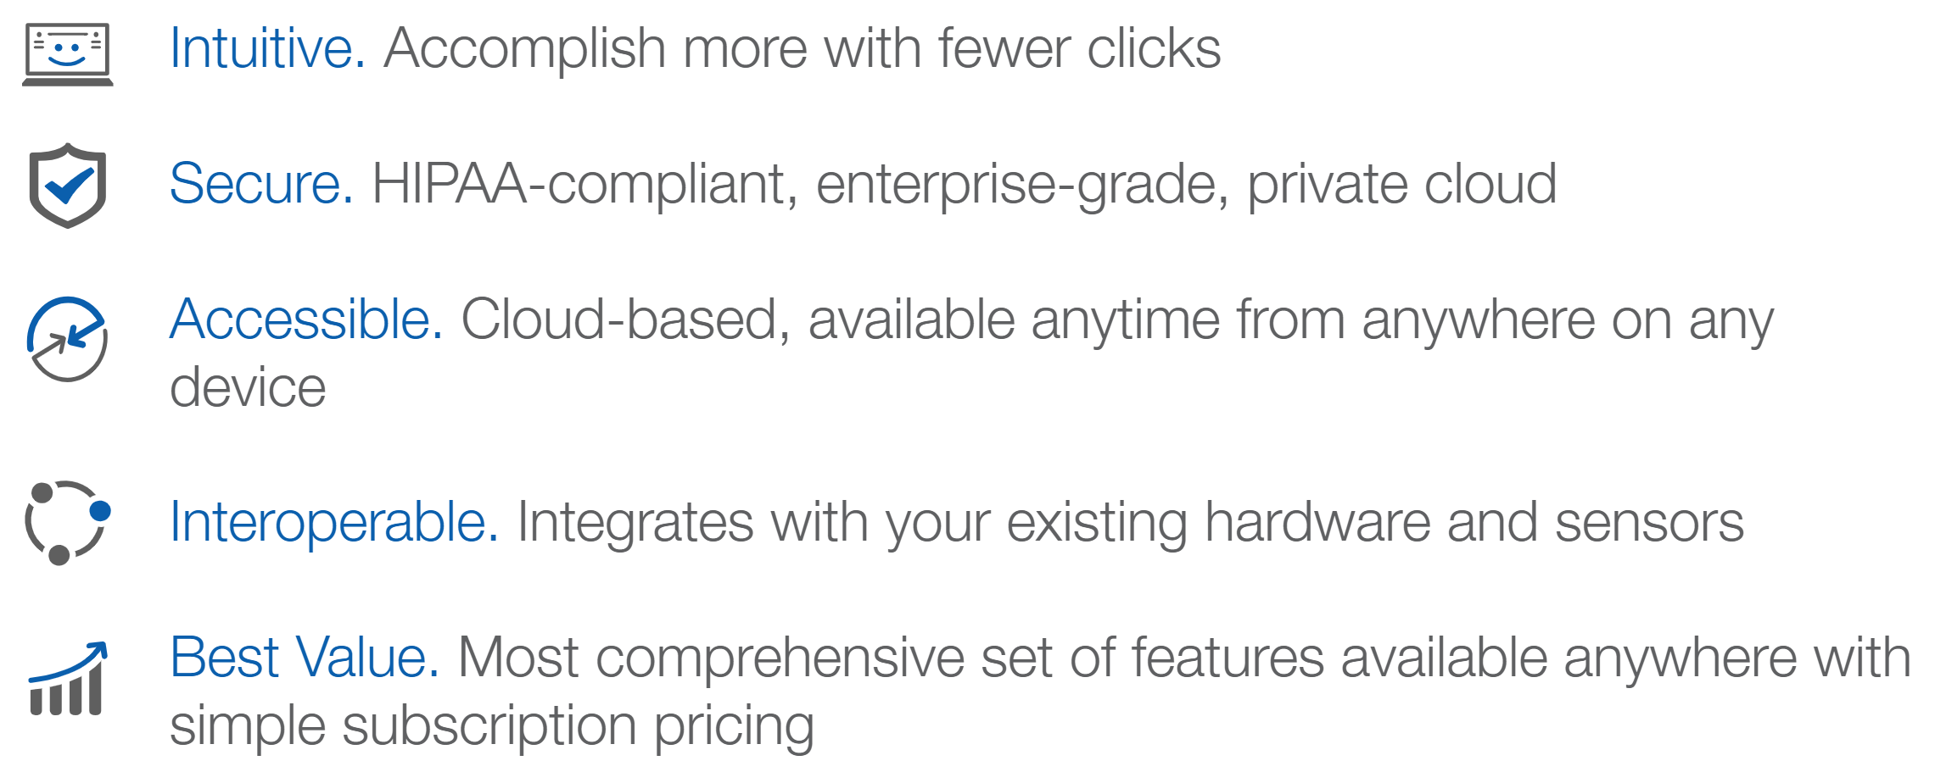
Why iDentalSoft?

Slide 11
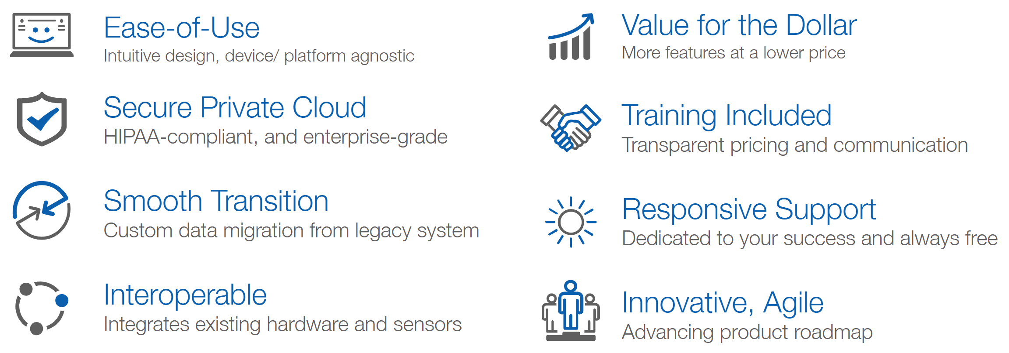

Slide 12
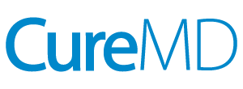
…and because it integrates with

Slide 13
What markets are iDentalSoft a solution for?
iDentalSoft One Solution supports:
Start-up
Single Practice
Multi Practices
FQHC – Support UDS Reporting. Have HL7 bi-diectional integration. Partnership with CureMD to expand the One Solution = Medical+Dental.
Dental Clinic – Support 837D for ADA dental claim and 837i for UB-04 claim

Slide 14
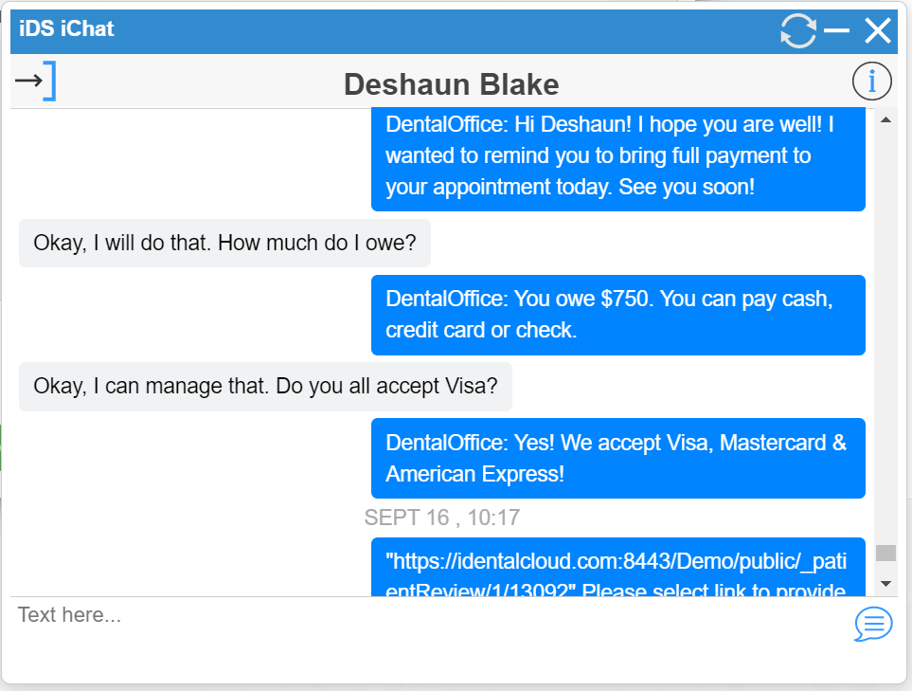
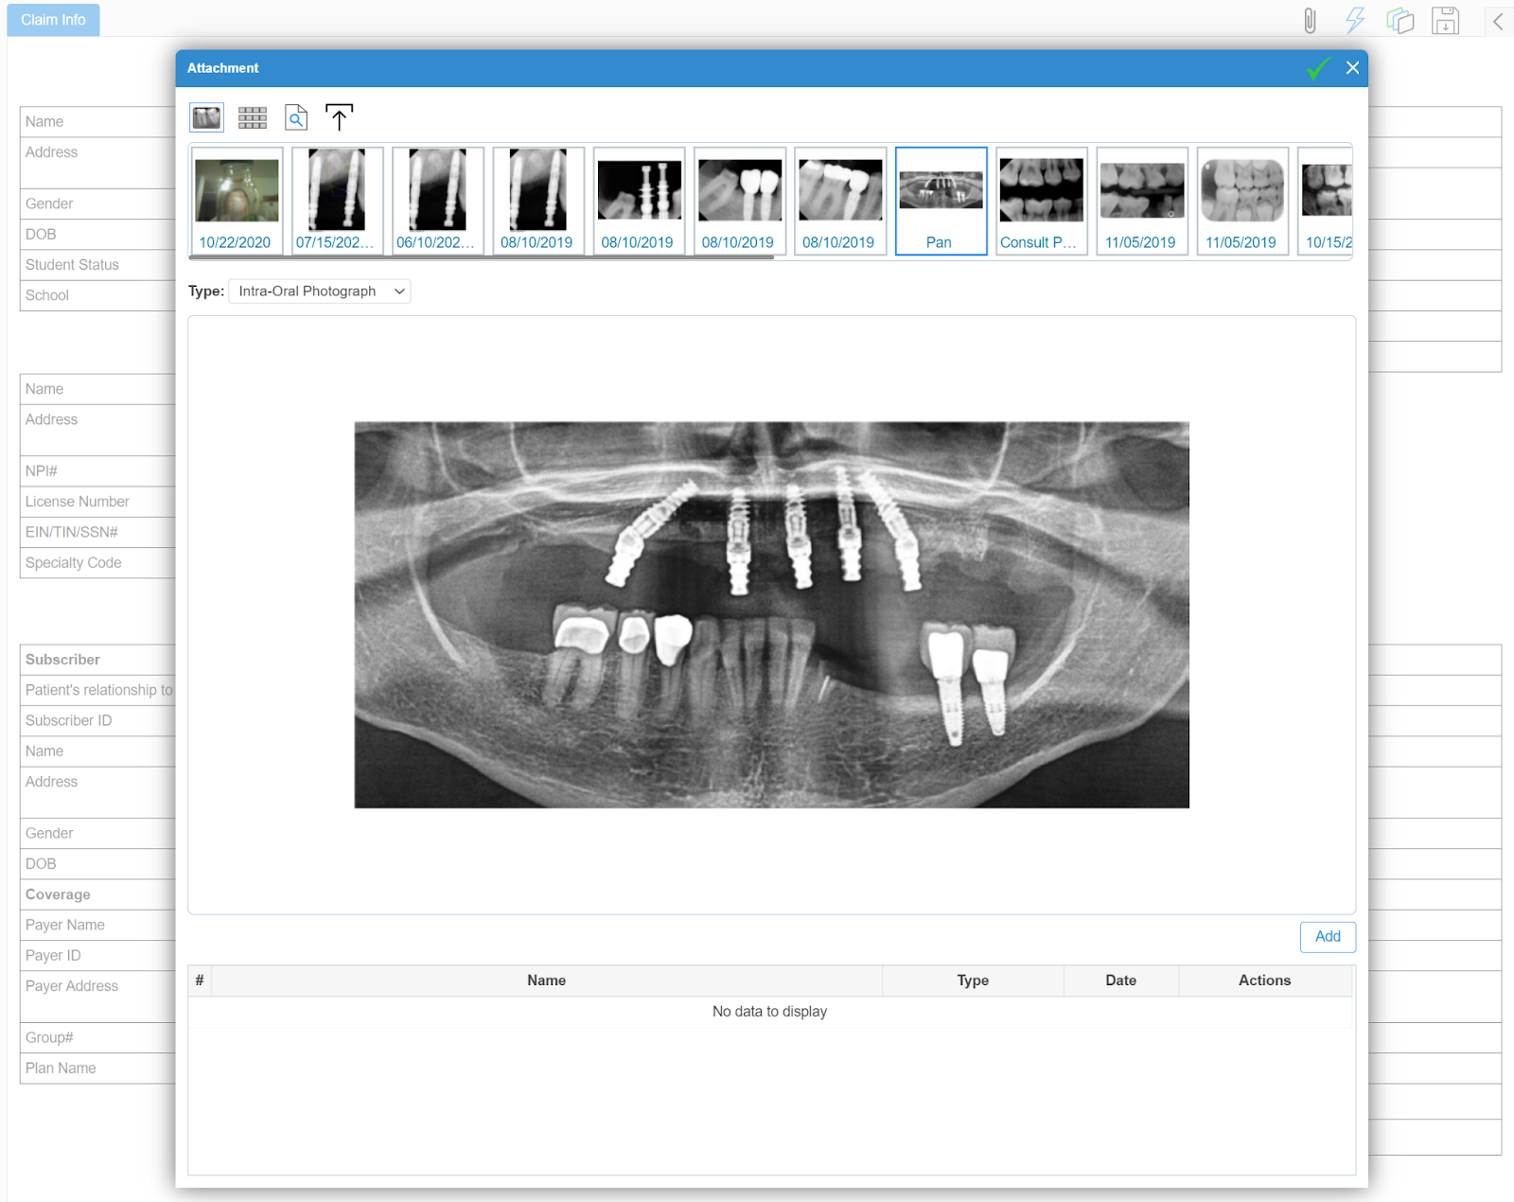
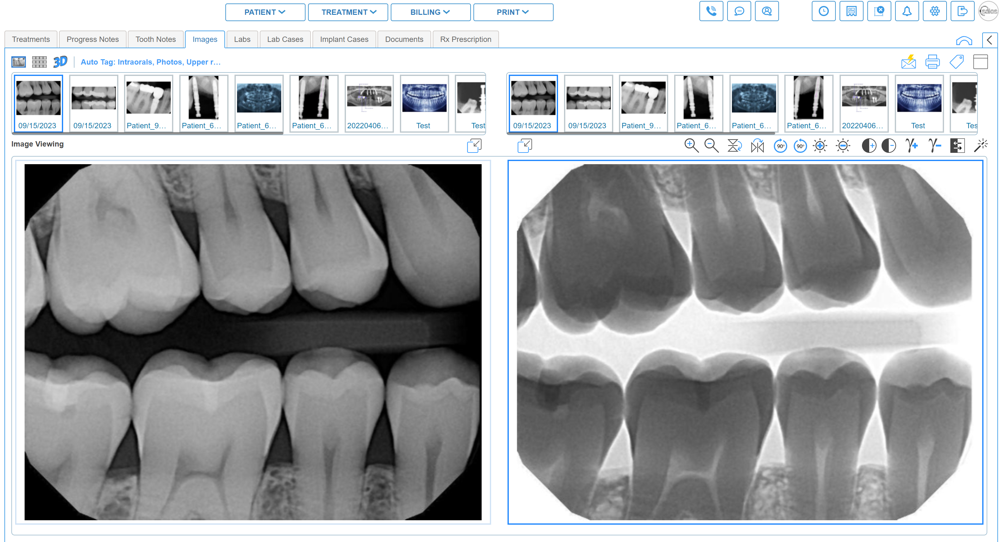
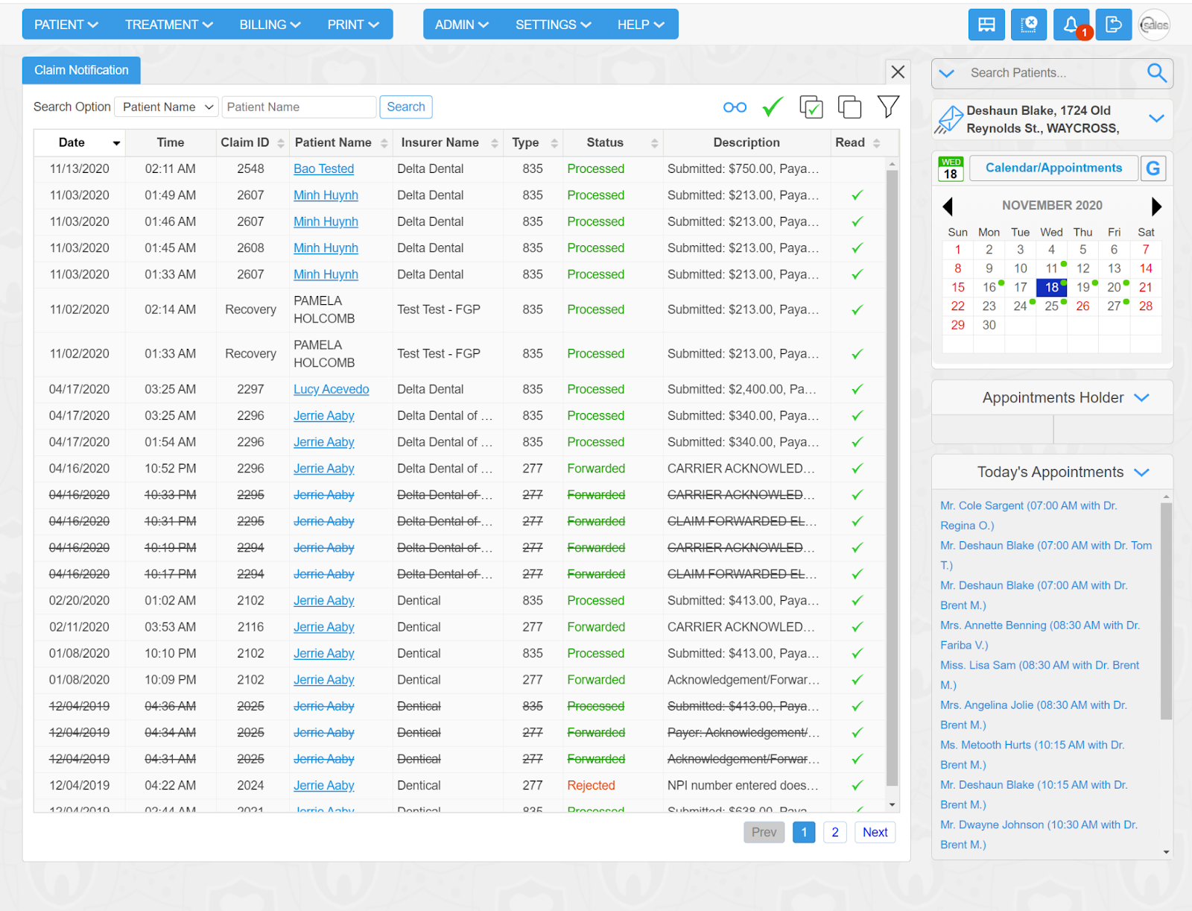
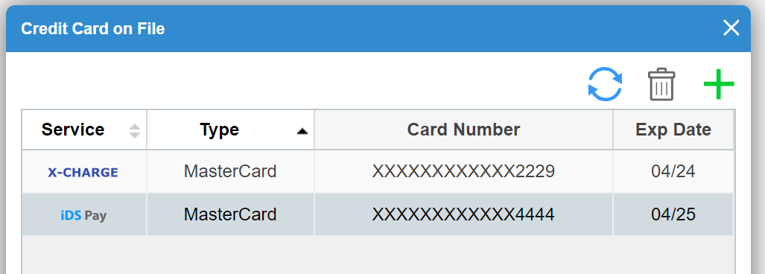
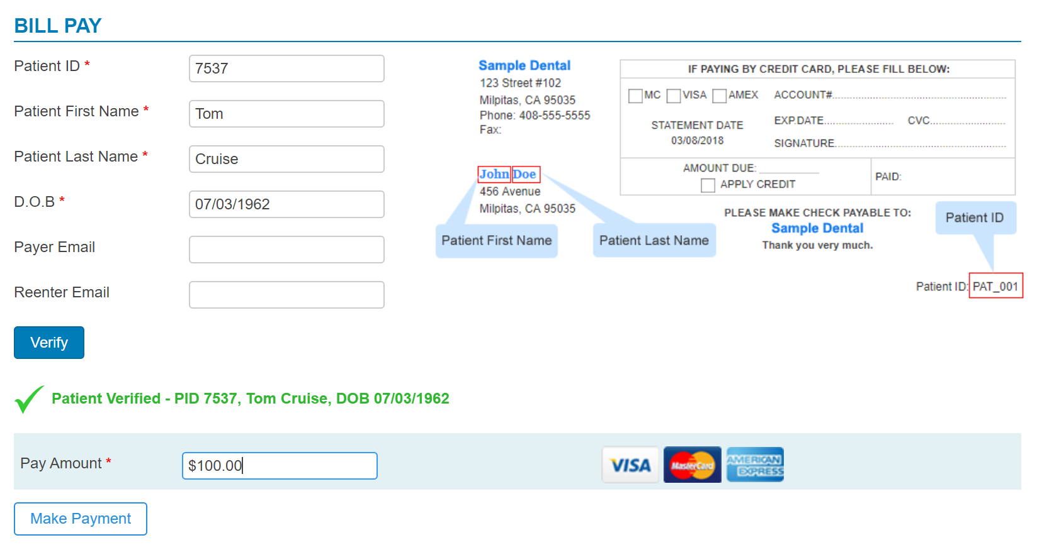
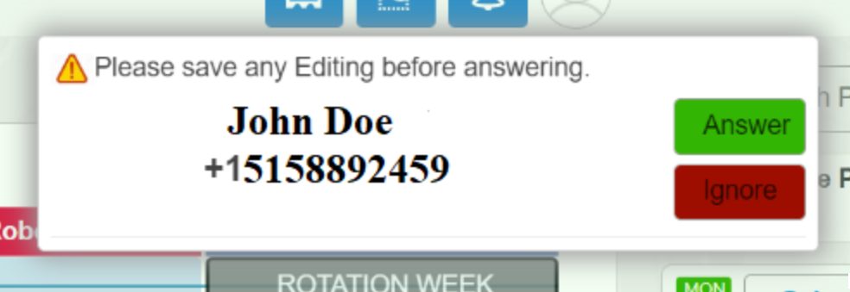
What services are offered within iDentalSoft?
2-way Texting
eClaims, attachments, ERA’s
Imaging Software (xray/Pano/Intra oral)
Payment Processing
Electronic Faxing
Virtual Phone Service

Slide 15
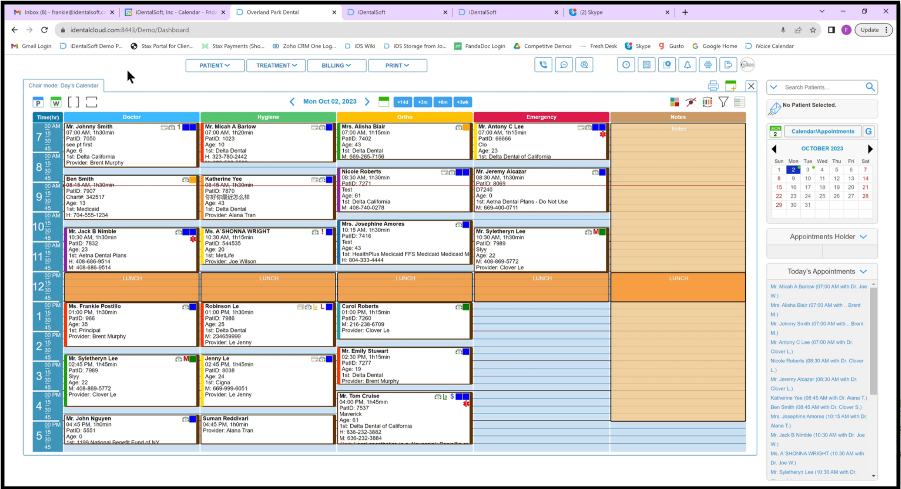
Watch it Live!

Slide 16
Thanks for listening!
Any questions?

